Slide 1

Chapter 5
Managing Users and Groups

Slide 2
What is a user?
Each user has a unique user id (UID)
Each group has a unique group id (GID)
Every user must belong to at least one group (primary group)
Users may belong to other groups (secondary groups)
Access is controlled via the UIDs and GIDs
Very simplistic compared to Windows Install ACLs on Linux for more fine-grained control

Slide 3
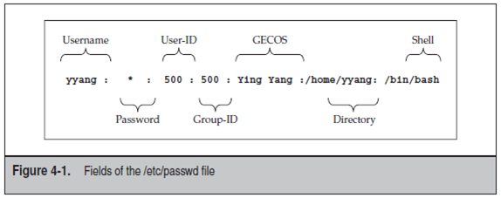
/etc/passwd
Notes:
GECOS = General Electric Comprehensive Operating System
Password is encrypted in /etc/shadow in DES format so it doesn’t appear here
uid is unique and root is generally user id 0
uids lower than 500 are generally used by system accounts (processes etc.)
Check the permissions of the /etc/passwd – is that secure??

Slide 4
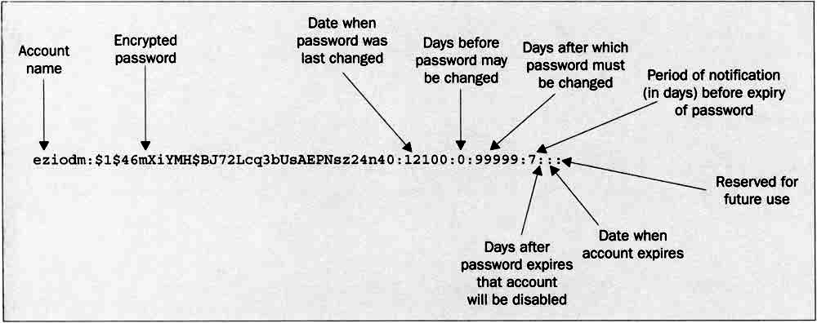
/etc/shadow
Notes:
Compare permissions between /etc/passwd and /etc/shadow (old programs need access to /etc/passwd)
Can look at the epoch date using date +%s
Uses DES encryption on older systems MD5 on more modern systems can be changed
authconfig --test
authconfig --test | grep hashing
Good passwords prevent dictionary attacks
Ask what makes a good password before moving to next slide
Login name
Encrypted password
Days since January 1, 1970, that password was last changed
Days before password may be changed
Days after which password must be changed
Days before password is to expire that user is warned
Days after password expires that account is disabled
Days since January 1, 1970, that account is disabled
A reserved field

Slide 5
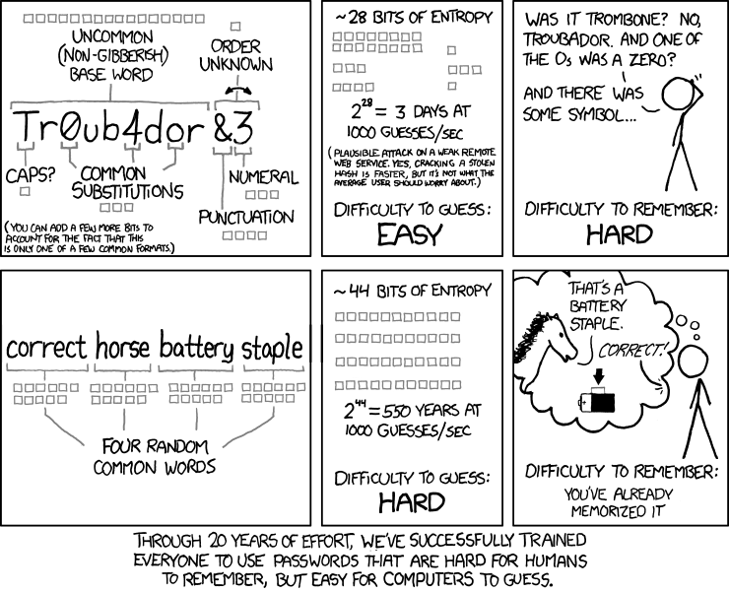

Slide 6
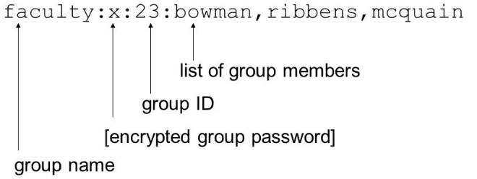
/etc/group
Notes:
Note that it users the username and not the uid in the group file

Slide 7
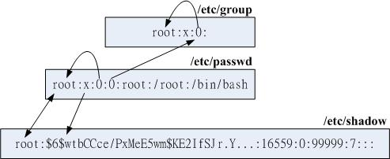
Tying them together

Slide 8
useradd/usermod
$ sudo useradd [options] username
-c, --comment COMMENT GECOS field of the new account -d, --home-dir HOME_DIR home directory of the new account -e, --expiredate EXPIRE_DATE expiration date of the new account -G, --groups GROUPS list of supplementary groups of the new account -m, --create-home create the user's home directory -p, --password PASSWORD encrypted password of the new account -s, --shell SHELL login shell of the new account
Notes:
NOTE: password must be encrypted if used with useradd

Slide 9
groupadd/groupmod
$ sudo groupadd [options] groupname
-g, --gid GID use GID for the new group -p, --password PASSWORD use this encrypted password for the group -r, --system create a system account
$ sudo groupmod [options] groupname
-g, --gid GID change the group ID to GID -n, --new-name NEW_GROUP change the name to NEW_GROUP -p, --password PASSWORD change the password to this (encrypted) PASSWORD

Slide 10
userdel/groupdel
$ sudo userdel [-r] username
-r, remove remove home directory and mail spool
$ sudo groupdel groupname

Slide 11
chage
Option | What it does
-E | Date the account will expire.
-I | Set the number of days of inactivity after a password has expired before the account is locked.
-m | Set the minimum number of days between password changes.
-M | Set the maximum number of days that a password is valid.
-W | Set the number of days of warning before a password change is required
-l | Show the account aging information

Slide 12
chage example
$ sudo chage –l dave
Last password change : May 21, 2018 Password expires : never Password inactive : never Account expires : never Minimum number of days between password change : 0 Maximum number of days between password change : 99999 Number of days of warning before password expires : 7

Slide 13
SetUID
SetUID is a security tool that permits users to run certain programs with escalated privileges.
When an executable file's setuid permission is set, users may execute that program with a level of access that matches the user who owns the file.
$ ls –l /bin/ping -rwsr-xr-x 1 root root 44168 May 7 2014 /bin/ping
$ chmod 4755 ~/myfile

Slide 14
SetGID
Similar to SetUID, but can be applied to both executables and directories.
When set on an executable, it will run with the privileges of the group.
When set on a directory, any files created in that directory will inherit the group setting of the directory.
$ mkdir ~/mydir $ chmod 2755 ~/mydir $ ls –l drwxr-sr-x 2 dmc1208 dmc1208 4096 Nov 20 12:51 mydir

Slide 15
PAM (pluggable authentication modules)
A flexible way of abstracting authentication from the operating system.
When authentication is required, Linux passes the request to PAM.
At its simplest PAM will simply check /etc/passwd and /etc/shadow.

Slide 16
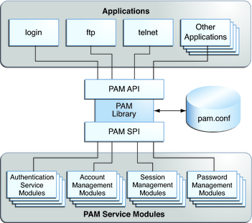
PAM Modules
Authentication Management (auth)
User Identity
Account Management (account)
Policy based
Password Management (password)
Manages password policies
Session Management (session)
Login console

